Slide 1
Chapter 1 Introduction

Slide 2
Table of Contents
Introduction
Lessig’s Four Modalities Analysis
Globalization
The Digital Divide

Slide 3
Introduction
From the 1960s to now, computers have becoming exponentially more powerful and linearly cheaper in most terms:
processing power
Ghz speed
Megaflops
memory storage capacity (RAM)
network bandwidth (Mbps)

Slide 4
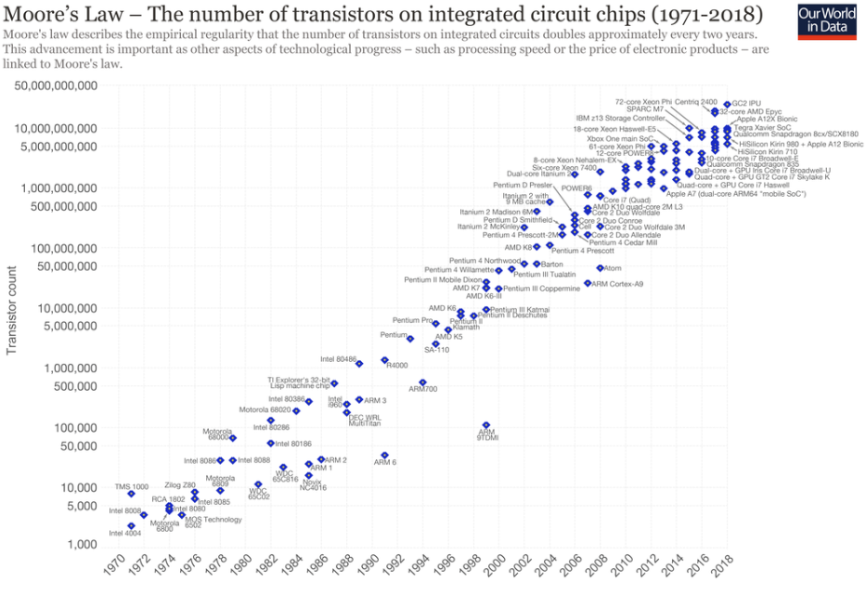
Introduction – Moore’s Law
Moore’s Law is a computing term which originated around 1970; the simplified version of this law states that processor speeds (number of transistor), or overall processing power for computers will double every two years.
Now? → Duad Core CPU → CPU speed doubled each year.
Source: https://en.wikipedia.org/wiki/Moore%27s_law
Notes:
Moore’s Law is a computing term which originated around 1970; the simplified version of this law states that processor speeds, or overall processing power for computers will double every two years. A quick check among technicians in different computer companies shows that the term is not very popular but the rule is still accepted.
To break down the law even further, it specifically stated that the number of transistors on an affordable CPU would double every two years (which is essentially the same thing that was stated before) but ‘more transistors’ is more accurate.
If you were to look at processor speeds from the 1970’s to 2009 and then again in 2010, one may think that the law has reached its limit or is nearing the limit. In the 1970’s processor speeds ranged from 740 KHz to 8MHz; notice that the 740 is KHz, which is Kilo Hertz – while the 8 is MHz, which is Mega Hertz.
From 2000 – 2009 there has not really been much of a speed difference as the speeds range from 1.3 GHz to 2.8 GHz, which suggests that the speeds have barely doubled within a 10 year span. This is because we are looking at the speeds and not the number of transistors; in 2000 the number of transistors in the CPU numbered 37.5 million, while in 2009 the number went up to an outstanding 904 million; this is why it is more accurate to apply the law to transistors than to speed.
With all this talk of transistors the average technician or computer user may not understand what the figures mean; a simpler way to explain is that the earlier CPUs on the market had a single speed or frequency rating while the newer models have a rating which refers to more than one CPU.
If you’ve purchased a computer recently you might have an idea of what this means as salespersons may have sold you on the wonders of multi-core CPUs. In the example given above, the speeds over a large number of years went between 1.3 and 2.8, which is barely double but what needs to be kept in mind is that the 2.8 is a QUAD CORE while the 1.3 is a single CORE. This means that the actual power of the 2.8 would be found if you multiply by four – which would give you a whopping 11.2 which is a far cry from 1.3.
Due to the rapid rate that technology has grown in the past few years, most computer technicians you speak with – whether they have heard of Moore’s Law or not will tell you that CPU speeds double each year. Though Moore’s Law had said every two years, this rapid increase in technological production has lessened the period in the minds of technicians and users alike.
The limitation which exists is that once transistors can be created as small as atomic particles, then there will be no more room for growth in the CPU market where speeds are concerned
http://www.mooreslaw.org/

Slide 5
Introduction - Risks
The combination of dependence on the correct functioning of these devices and the potential for abuse and misuse by both their owners and third parties (governments, criminals, pranksters or commercial interests) creates the biggest risks that industrial societies have ever faced.
It is suggested that we are now in the midst of a social revolution every bit as far-reaching as the industrial revolution: the ‘information revolution’ moving us from the industrial age to the information age.

Slide 6
Introduction – Importance of IT Pros
Computing professionals must now consider their work in the same light as the chemist and the nuclear physicist in terms of its potential impact on individuals and society

Slide 7
Introduction – Importance of IT Pros
What are the effects of your/your colleagues’ work on society?

Slide 8
LESSIG’S FOUR MODALITIES ANALYSIS

Slide 9





Lessig’s Four Modalities Analysis
Law
Architecture
Individual/Technological trend/Phenomenon
Markets
Social Norms
Notes:
In the physical world, architecture means physics and geography but online architecture is simply computer code.

Slide 10
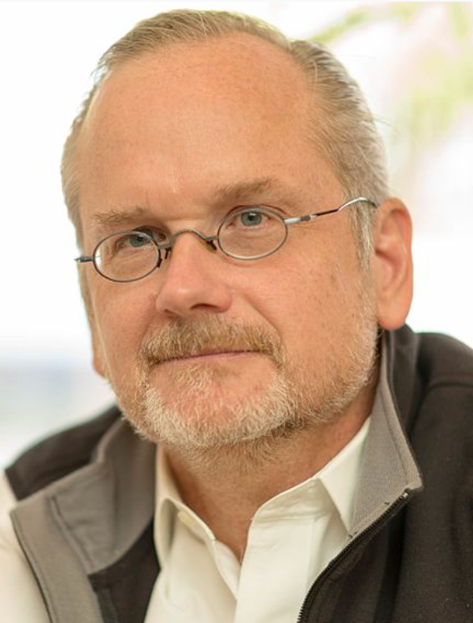
Lessig’s Four Modalities Analysis
In his seminal 1999 book, Professor Lawrence Lessig described a means of considering how technology and human society interact.
4 interconnected influences on human behavior: law, social norms, markets and architecture
Law: expressed and enforced power of the state
Social norms: pressure put on by people we know
Markets: economic realities and how they influence behavior
Architecture: online architecture = computer code.
Source: https://en.wikipedia.org/wiki/Lawrence_Lessig
Notes:
In the physical world, architecture means physics and geography but online architecture is simply computer code.

Slide 11
Lessig’s Four Modalities Analysis
Each of these influences interacts with the others and puts pressure on the individual.
Each is also acted on by society as a whole.
Notes:
In the physical world, architecture means physics and geography but online architecture is simply computer code.

Slide 12
Practice
The smart phone is an invention that has emerged in this new millennium. Explain its impact using Lawrence Lessig's Four Modalities Analysis.

Slide 13
Lessig’s Four Modalities Analysis
Law
The rise of smart phone
Architecture
Markets
Social Norms
Notes:
In the physical world, architecture means physics and geography but online architecture is simply computer code.

Slide 14
GLOBALIZATION

Slide 15
Globalization
Process of creating a worldwide network of businesses and markets
Globalization causes a greater mobility of goods, services, and capital around the world
Globalization made possible through rapidly decreasing cost of information technology
Due to modern computer and communication technology, the barriers between societies are being reduced
WWW is accelerating this globalization of information

Slide 16
Globalization - Benefits
Increases competition (leading to lower price)
Provides global jobs
Establish global economies
Create capitalistic and democratic political systems
Foreign exchange allows more products and services to be available, while also lowering costs, because of specialization
And many more…

Slide 17
Globalization – Unfavorable Effects
Conflict
Example: the violent protests in 2006 in Indonesia against publication in 2005 in a Danish newspaper of cartoons satirizing the prophet Muhammad.
Problems of jurisdiction
Increased clash of cultures
Environmental impacts
Increased competition for goods/services/jobs
Pandemic outbreak (Covid-19, etc)
And many more…

Slide 18
THE DIGITAL DIVIDE

Slide 19
The Digital Divide
Digital divide: Some people have access to modern information technology while others do not
Underlying assumption: people with access to telephones, computers, Internet have opportunities denied to those without access
Concept of digital divide became popular with emergence of World Wide Web

Slide 20
The Digital Divide
Example: automated trading used by the rich
Automated trading – computer is used to buy/sell stocks and bonds without human interaction
Automatic trading is lessened by regulations in which deliberate delays in processing trades or decision making have had to be introduced to avoid too much volatility in the markets

Slide 21
The Digital Divide
Individual Stock Market Trading: Pump and Dump Scams
price of a stock is ‘pumped up’ by spreading rumours that there is some reason it is about to jump
Once enough people have bought in, driving the price up (the pump), the original holders of the stock sell at a vastly inflated price (the dump)
This leaves those who fell for the rumour to take the losses as the stock adjusts back to its natural price

